Slide 1
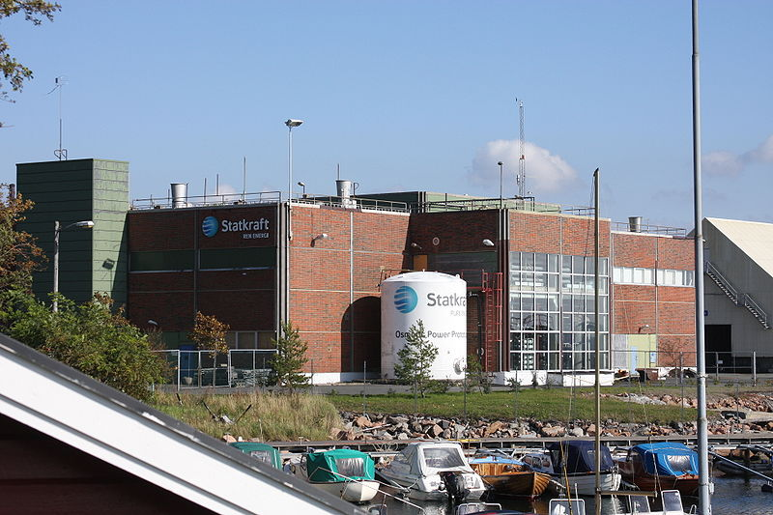
OSMOTIC POWER
Osmotic power or salinity gradient power is the energy available from the difference in the salt concentration between seawater and river water. Two practical methods for this are reverse electrodialysis (RED) and pressure retarded osmosis (PRO). Both processes rely on osmosis with ion specific membranes. The key waste product is brackish water. This byproduct is the result of natural forces that are being harnessed: the flow of fresh water into seas that are made up of salt water.
The method of generating power by pressure retarded osmosis was invented by Prof. Sidney Loeb in 1973 at the Ben-Gurion University of the Negev, Beersheba, Israel. The idea came to Prof. Loeb, in part, as he observed the Jordan River flowing into the Dead Sea. He wanted to harvest the energy of mixing of the two aqueous solutions (the Jordan River being one and the Dead Sea being the other) that was going to waste in this natural mixing process. In 1977, Prof. Loeb invented a method of producing power by a reverse electrodialysis heat engine.
Osmotic Power Prototype at Tofte, Norway

Slide 2
The technologies have been confirmed in laboratory conditions. They are being developed into commercial use in the Netherlands (RED) and Norway (PRO). The cost of the membrane has been an obstacle. A new, lower cost membrane, based on an electrically modified polyethylene plastic, made it fit for potential commercial use. Other methods have been proposed and are currently under development. Among them, a method based on electric double-layer capacitor technology, and a method based on vapor pressure difference.
The world's first osmotic power plant with capacity of 4 kW was opened by Statkraft on 24 November 2009 in Tofte, Norway. The plant utilized the original schematic proposed by Loeb. This plant uses polyimide as a membrane, and is able to produce 1W/m² of membrane. This amount of power is obtained with water flow through the membrane of 10 L/s, at a pressure of 1 MPa. Both the increasing of the pressure as well as the flow rate of the water would make it possible to increase the power output.

Slide 3
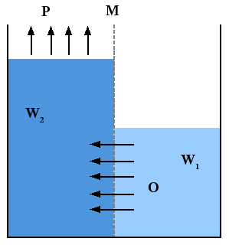
BASICS OF PRESSURE RETARDED OSMOSIS
Salinity gradient power is a specific renewable energy alternative that creates renewable and sustainable power by using naturally occurring processes. This practice does not contaminate or release carbon dioxide (CO₂) emissions (vapor pressure methods will release dissolved air containing CO₂ at low pressures—these non-condensable gases can be re-dissolved of course, but with an energy penalty). As stated by Jones and Finley within their article “Recent Development in Salinity Gradient Power”, there is basically no fuel cost.
Salinity gradient energy is based on using the resources of “osmotic pressure difference between fresh water and sea water.” All energy that is proposed to use salinity gradient technology relies on the evaporation to separate water from salt. Osmotic pressure is the "chemical potential of concentrated and dilute solutions of salt". When looking at relations between high osmotic pressure and low, solutions with higher concentrations of salt have higher pressure.

Slide 4
Differing types of salinity gradient power generators exist but one of the most commonly discussed is pressure-retarded osmosis (PRO). Within PRO, seawater is pumped into a pressure chamber where the pressure is lower than the difference between fresh and salt water pressure. Fresh water moves in a semipermeable membrane and increases its volume in the chamber. As the pressure in the chamber is compensated a turbine spins to generate electricity.
This process is easy to understand in a more broken down manner. Two solutions, A being salt water and B being fresh water are separated by a membrane. Only water molecules can pass through the semipermeable membrane. As a result of the osmotic pressure difference between both solutions, the water from solution B thus will diffuse through the membrane in order to dilute the solution. The pressure drives the turbines and power the generator that produces the electrical energy.
A recent study on efficiency from Yale university concluded that the highest extractable work in constant-pressure PRO with a seawater drawn solution and river water feed solution is 0.75 kWh/m³ while the free energy of mixing is 0.81 kWh/m³—a thermodynamic extraction efficiency of 91.1%.

Slide 5
While the mechanics and concepts of salinity gradient power are still being studied, the power source has been implemented in several different locations. Most of these are experimental, that’s why they have been predominantly successful. The various companies that have utilized this power have also done so in many different ways as there are several concepts and processes that harness the power from salinity gradient.
Pressure-retarded osmosis
In this method, seawater is pumped into a pressure chamber that is at a pressure lower than the difference between the pressures of saline water and fresh water. Freshwater is also pumped into the pressure chamber through a membrane, which increase both the volume and pressure of the chamber. As the pressure differences are compensated, a turbine is spun, providing kinetic energy.
This method is being specifically studied by the Norwegian utility Statkraft, which has calculated that up to 25 TWh/yr would be available from this process in Norway. It aims to produce enough electricity to light and heat a small town within five years by osmosis. At first it will produce a minuscule 4 kilowatts – enough to heat a large electric kettle, but by 2015 the target is 25 megawatts – the same as a small wind farm.

Slide 6
Reversed electrodialysis
A second method being developed and studied is reversed electrodialysis or reverse dialysis, which is essentially the creation of a salt battery. This method was described by Weinstein and Leitz as “an array of alternating anion and cation exchange membranes can be used to generate electric power from the free energy of river and sea water.”
The technology related to this type of power is still in its infant stages, even though the principle was discovered in the 1950s. Standards and a complete understanding of all the ways salinity gradients can be utilized are important goals to strive for in order to make this clean energy source more viable in the future.

Slide 7
Capacitive method
A third method is Doriano Brogioli's capacitive method, which is relatively new and has so far only been tested on lab scale. With this method energy can be extracted out of the mixing of saline water and freshwater by cyclically charging up electrodes in contact with saline water, followed by a discharge in freshwater. Since the amount of electrical energy which is needed during the charging step is less than one gets out during the discharge step, each completed cycle effectively produces energy. An intuitive explanation of this effect is that the great number of ions in the saline water efficiently neutralizes the charge on each electrode by forming a thin layer of opposite charge very close to the electrode surface, known as an electric double layer. Therefore, the voltage over the electrodes remains low during the charge step and charging is relatively easy. In between the charge and discharge step, the electrodes are brought in contact with freshwater. After this, there are less ions available to neutralize the charge on each electrode such that the voltage over the electrodes increases. The discharge step which follows is therefore able to deliver a relatively high amount of energy. A physical explanation is that on an electrically charged capacitor, there is a mutually attractive electric force between the electric charge on the electrode, and the ionic charge in the liquid. In order to pull ions away from the charged electrode, osmotic pressure must do work. This work done increases the electrical potential energy in the capacitor. An electronic explanation is that capacitance is a function of ion density. By introducing a salinity gradient and allowing some of the ions to diffuse out of the capacitor, this reduces the capacitance, and so the voltage must increase, since the voltage equals the ratio of charge to capacitance.

Slide 8
Vapor pressure differences : open cycle and absorption refrigeration cycle (closed cycle)
Both of these methods do not rely on membranes, so filtration requirements are not as important as they are in the PRO & RED schemes.
Open cycle
Similar to the open cycle in ocean thermal energy conversion (OTEC). The disadvantage of this cycle is the cumbersome problem of a large diameter turbine operating at below atmospheric pressure to extract the power between the water with less salinity and the water with greater salinity.
Absorption refrigeration cycle (closed cycle)
For the purpose of dehumidifying air, in a water-spray absorption refrigeration system, water vapor is dissolved into a deliquescent salt water mixture using osmotic power as an intermediary. The primary power source originates from a thermal difference, as part of a thermodynamic heat engine cycle.

Slide 9
Solar pond
At the Eddy Potash Mine in New Mexico, a technology called "salinity gradient solar pond" (SGSP) is being utilized to provide the energy needed by the mine. This method does not harness osmotic power, but only solar power. Sunlight reaching the bottom of the saltwater pond is absorbed as heat. The effect of natural convection, wherein "heat rises", is blocked using density differences between the three layers that make up the pond, in order to trap heat. The upper convection zone is the uppermost zone, followed by the stable gradient zone, then the bottom thermal zone. The stable gradient zone is the most important. The saltwater in this layer can not rise to the higher zone because the saltwater above has lower salinity and is therefore less-dense and more buoyant; and it can not sink to the lower level because that saltwater is denser. This middle zone, the stable gradient zone, effectively becomes an "insulator" for the bottom layer (although the main purpose is to block natural convection, since water is a poor insulator). This water from the lower layer, the storage zone, is pumped out and the heat is used to produce energy, usually by turbine in an organic Rankine cycle.
In theory a solar pond could be used to generate osmotic power if evaporation from solar heat is used to create a salinity gradient, and the potential energy in this salinity gradient is harnessed directly using one of the first three methods above, such as the capacitive method.

Slide 10
Boron nitride nanotubes
A research team built an experimental system using boron nitride that can produce much power. It used an impermeable and electrically insulating membrane that was pierced by a single boron nitride nanotube with an external diameter of nanometers. With this membrane separating a salt water reservoir and a fresh water reservoir, the team measured the electric current passing through the membrane using two electrodes immersed in the fluid either side of the nanotube.
The results showed the device was able to generate an electric current on the order of a nanoampere. The researchers claim this is 1,000 times the yield of other known techniques for harvesting osmotic energy and makes boron nitride nanotubes an extremely efficient solution for harvesting the energy of salinity gradients for usable electrical power.
The team claimed that a 1 square meter (11 sq ft) membrane could generate around 4 kW and be capable of generating up to 30 MWh per year.

Slide 11
Possible negative environmental impact
Marine and river environments have obvious differences in water quality, namely salinity. Each species of aquatic plant and animal is adapted to survive in either marine, brackish, or freshwater environments. There are species that can tolerate both, but these species usually thrive best in a specific water environment. The main waste product of salinity gradient technology is brackish water. The discharge of brackish water into the surrounding waters, if done in large quantities and with any regularity, will cause salinity fluctuations. While some variation in salinity is usual, particularly where fresh water (rivers) empties into an ocean or sea anyway, these variations become less important for both bodies of water with the addition of brackish waste waters. Extreme salinity changes in an aquatic environment may result in findings of low densities of both animals and plants due to intolerance of sudden severe salinity drops or spikes. According to the prevailing environmentalist opinions, the possibility of these negative effects should be considered by the operators of future large blue energy establishments.
The impact of brackish water on ecosystems can be minimized by pumping it out to sea and releasing it into the mid-layer, away from the surface and bottom ecosystems.

Slide 12
ENZYMATIC BIO FUEL CELL
An Enzymatic biofuel cell is a specific type of fuel cell that uses enzymes as a catalyst to oxidize its fuel, rather than precious metals. Enzymatic biofuel cells, while currently confined to research facilities, are widely prized for the promise they hold in terms of their relatively inexpensive components and fuels, as well as a potential power source for bionic implants.
Enzymatic biofuel cells work on the same general principles as all fuel cells: use a catalyst to separate electrons from a parent molecule and force it to go around an electrolyte barrier through a wire to generate an electric current.
What makes the enzymatic biofuel cell distinct from more conventional fuel cells are the catalysts they use and the fuels that they accept. Whereas most fuel cells use metals like platinum and nickel as catalysts, the enzymatic biofuel cell uses enzymes derived from living cells (although not within living cells; fuel cells that use whole cells to catalyze fuel are called microbial fuel cells). This offers a couple of advantages for enzymatic biofuel cells: Enzymes are relatively easy to mass-produce and so benefit from economies of scale, whereas precious metals must be mined and so have an inelastic supply. They do not suffer from the contamination problems that more traditional metallic catalysts suffer from. They are also incredibly abundant and cheap to produce, something that the wine and detergent industries have known for decades.

Slide 13
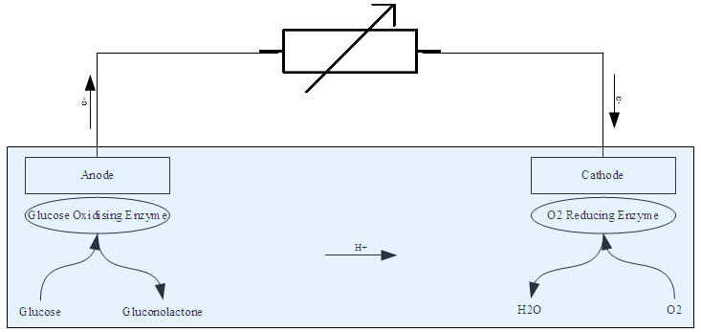
A general diagram for an enzymatic biofuel cell using Glucose and Oxygen. The blue area indicates the electrolyte.

Slide 14
But applying enzymes to power electronics is very different from getting enzymes to clean our clothes. Enzymes do not like to give up electrons as easily as metal catalysts do, which means that generating an electric current from enzymes is much tougher. Enzymes can be made to give up their electrons with mediators, but using mediators can cause other problems in the fuel cell. Enzymes also are not used to staying put. In animals, enzymes are floating freely in the cells of the body, but to work in a fuel cell, they have to be put in a specific place and stay there, a process that scientists call immobilizing the enzymes. Finally, naturally occurring enzymes do not last that long. A typical enzyme in the human body lasts only a couple of days, but to be effective in a laptop or an automobile, an enzyme is going to have to last for months or years before needing replacement. Enzymes are also specifically designed to process organic compounds such as sugars and alcohols, which are extremely common in nature. Most organic compounds cannot be used as fuel by fuel cells with metal catalysts because the carbon monoxide formed by the interaction of the carbon molecules with oxygen during the fuel cell’s functioning will quickly “poison” the precious metals that the cell relies on, rendering it useless. Because sugars and other biofuels can be grown and harvested on a massive scale, the fuel for enzymatic biofuel cells is extremely cheap and can be found in nearly any part of the world, thus making it an extraordinarily attractive option from a logistics standpoint, and even more so for those concerned with the adoption of renewable energy sources.

Slide 15
Enzymatic biofuel cells also have operating requirements not shared by traditional fuel cells. What is most significant is that the enzymes that allow the fuel cell to operate must be “immobilized” near the anode and cathode in order to work properly; if not immobilized, the enzymes will diffuse into the cell’s fuel and most of the liberated electrons will not reach the electrodes, compromising its effectiveness. Even with immobilization, means must also be provided for electrons to be transferred to and from the electrodes. This can be done either directly from the enzyme to the electrode (“direct electron transfer”) or with the aid of other chemicals that transfer electrons from the enzyme to the electrode (“mediated electron transfer”). The former technique is possible only with certain types of enzymes whose activation sites are close to the enzyme’s surface, but doing so presents fewer toxicity risks for fuel cells intended to be used inside the human body. Finally, completely processing the complex fuels used in enzymatic biofuel cells requires a series of different enzymes for each step of the ‘metabolism’ process; producing some of the required enzymes and maintaining them at the required levels can pose problems.

Slide 16
Early work with biofuel cells, which began in the early 20th century, was purely of the microbial variety. Research on using enzymes directly for oxidation in biofuel cells began in the early 1960s, with the first enzymatic biofuel cell being produced in 1964. This research began as a product of NASA’s interest in finding ways to recycle human waste into usable energy on board spacecraft, as well as a component of the quest for an artificial heart, specifically as a power source that could be put directly into the human body. These two applications – use of animal or vegetable products as fuel and development of a power source that can be directly implanted into the human body without external refueling – remain the primary goals for developing these biofuel cells. Initial results, however, were disappointing. While the early cells did successfully produce electricity, there was difficulty in transporting the electrons liberated from the glucose fuel to the fuel cell’s electrode and further difficulties in keeping the system stable enough to produce electricity at all due to the enzymes’ tendency to move away from where they needed to be in order for the fuel cell to function. These difficulties led to an abandonment by biofuel cell researchers of the enzyme-catalyst model for nearly three decades in favor of the more conventional metal catalysts (principally platinum), which are used in most fuel cells. Research on the subject did not begin again until the 1980s after it was realized that the metallic-catalyst method was not going to be able to deliver the qualities desired in a biofuel cell, and since then work on enzymatic biofuel cells has revolved around the resolution of the various problems that plagued earlier efforts at producing a successful enzymatic biofuel cell.

Slide 17
In 1998, it was announced that researchers had managed to completely oxidize methanol using a series (or “cascade”) of enzymes in a biofuel cell. Previously, the enzyme catalysts had failed to completely oxidize the cell’s fuel, delivering far lower amounts of energy than the energy capacity of the fuel. While methanol is now far less relevant in this field as a fuel, the demonstrated method of using a series of enzymes to completely oxidize the cell’s fuel gave researchers a way forward, and much work is now devoted to using similar methods to achieve complete oxidation of more complicated compounds, such as glucose. In addition, and perhaps what is more important, 1998 was the year in which enzyme “immobilization” was successfully demonstrated, which increased the usable life of the methanol fuel cell from just eight hours to over a week. Immobilization also provided researchers with the ability to put earlier discoveries into practice, in particular the discovery of enzymes that can be used to directly transfer electrons from the enzyme to the electrode. This process had been understood since the 1980s but depended heavily on placing the enzyme as close to the electrode as possible, which meant that it was unusable until after immobilization techniques were devised. In addition, developers of enzymatic biofuel cells have applied some of the advances in nanotechnology to their designs, including the use of carbon nanotubes to immobilize enzymes directly. Other research has gone into exploiting some of the strengths of the enzymatic design to dramatically miniaturize the fuel cells, a process that must occur if these cells are ever to be used with implantable devices. One research team took advantage of the extreme selectivity of the enzymes to completely remove the barrier between anode and cathode, which is an absolute requirement in fuel cells not of the enzymatic type. This allowed the team to produce a fuel cell that produces 1.1 microwatts operating at over half a volt in a space of just 10 cubic micrometers.

Slide 18
While enzymatic biofuel cells are not currently in use outside of the laboratory, as the technology has advanced over the past decade non-academic organizations have shown an increasing amount of interest in practical applications for the devices. In 2007, Sony announced that it had developed an enzymatic biofuel cell that can be linked in sequence and used to power an mp3 player, and in 2010 US Army announced that the Defense Department was planning to conduct field trials of its own "bio-batteries" in the following year. In explaining their pursuit of the technology, both organizations emphasized the extraordinary abundance (and extraordinarily low expense) of fuel for these cells, a key advantage of the technology that is likely to become even more attractive if the price of portable energy sources goes up, or if they can be successfully integrated into electronic human implants.

Slide 19
MICROBIAL FUEL CELL
A microbial fuel cell (MFC) or biological fuel cell is a bio-electrochemical system that drives a current by using bacteria and mimicking bacterial interactions found in nature. MFCs can be grouped into two general categories, those that use a mediator and those that are mediator-less. The first MFCs, demonstrated in the early 20th century, used a mediator: a chemical that transfers electrons from the bacteria in the cell to the anode. Mediator-less MFCs are a more recent development dating to the 1970s; in this type of MFC the bacteria typically have electrochemically active redox proteins such as cytochromes on their outer membrane that can transfer electrons directly to the anode. Since the turn of the 21st century, MFCs have started to find a commercial use in the treatment of wastewater.
The idea of using microbial cells in an attempt to produce electricity was first conceived in the early twentieth century. M. Potter was the first to perform work on the subject in 1911. A professor of botany at the University of Durham, Potter managed to generate electricity from E. coli, but the work did not receive any major coverage. In 1931, however, Barnet Cohen drew more attention to the area when he created a number of microbial half fuel cells that, when connected in series, were capable of producing over 35 volts, though only with a current of 2 milliamps.

Slide 20
More work on the subject came with a study by DelDuca et al. who used hydrogen produced by the fermentation of glucose by Clostridium butyricum as the reactant at the anode of a hydrogen and air fuel cell. Though the cell functioned, it was found to be unreliable owing to the unstable nature of hydrogen production by the micro-organisms. Although this issue was later resolved in work by Suzuki et al. in 1976, the current design concept of an MFC came into existence a year later with work once again by Suzuki.
By the time of Suzuki’s work in the late 1970s, little was understood about how microbial fuel cells functioned; however, the idea was picked up and studied later in more detail first by MJ Allen and then later by H. Peter Bennetto both from King's College London. People saw the fuel cell as a possible method for the generation of electricity for developing countries. His work, starting in the early 1980s, helped build an understanding of how fuel cells operate, and until his retirement, he was seen by many as the foremost authority on the subject.
It is now known that electricity can be produced directly from the degradation of organic matter in a microbial fuel cell. Like a normal fuel cell, an MFC has both an anode and a cathode chamber. The anoxic anode chamber is connected internally to the cathode chamber via an ion exchange membrane with the circuit completed by an external wire.
In May 2007, the University of Queensland, Australia completed its prototype MFC as a cooperative effort with Foster's Brewing. The prototype, a 10 L design, converts brewery wastewater into carbon dioxide, clean water, and electricity. With the prototype proven successful, plans are in effect to produce a 660 gallon version for the brewery, which is estimated to produce 2 kilowatts of power. While this is a small amount of power, the production of clean water is of utmost importance to Australia, for which drought is a constant threat.

Slide 21
Definition
A microbial fuel cell is a device that converts chemical energy to electrical energy by the catalytic reaction of microorganisms.
A typical microbial fuel cell consists of anode and cathode compartments separated by a cation (positively charged ion) specific membrane. In the anode compartment, fuel is oxidized by microorganisms, generating CO₂, electrons and protons. Electrons are transferred to the cathode compartment through an external electric circuit, while protons are transferred to the cathode compartment through the membrane. Electrons and protons are consumed in the cathode compartment, combining with oxygen to form water.
More broadly, there are two types of microbial fuel cell: mediator and mediator-less microbial fuel cells.
Mediator microbial fuel cell
Most of the microbial cells are electrochemically inactive. The electron transfer from microbial cells to the electrode is facilitated by mediators such as thionine, methyl viologen, methyl blue, humic acid, neutral red and so on. Most of the mediators available are expensive and toxic.

Slide 22
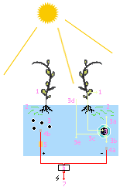
Mediator-free microbial fuel cells
Mediator-free microbial fuel cells do not require a mediator but use electrochemically active bacteria to transfer electrons to the electrode (electrons are carried directly from the bacterial respiratory enzyme to the electrode). Among the electrochemically active bacteria are, Shewanella putrefaciens, Aeromonas hydrophila, and others. Some bacteria, which have pili on their external membrane, are able to transfer their electron production via these pili. Mediator-less MFCs are a more recent area of research and, due to this, factors that affect optimum efficiency, such as the strain of bacteria used in the system, type of ion-exchange membrane, and system conditions (temperature, pH, etc.) are not particularly well understood.
Mediator-less microbial fuel cells can, besides running on wastewater, also derive energy directly from certain plants. This configuration is known as a plant microbial fuel cell. Possible plants include reed sweetgrass, cordgrass, rice, tomatoes, lupines, and algae. Given that the power is thus derived from living plants (in situ-energy production), this variant can provide additional ecological advantages.

Slide 23
Microbial electrolysis cell
A variation of the mediator-less MFC is the microbial electrolysis cells (MEC). Whilst MFC's produce electric current by the bacterial decomposition of organic compounds in water, MECs partially reverse the process to generate hydrogen or methane by applying a voltage to bacteria to supplement the voltage generated by the microbial decomposition of organics sufficiently lead to the electrolysis of water or the production of methane. A complete reversal of the MFC principle is found in microbial electrosynthesis, in which carbon dioxide is reduced by bacteria using an external electric current to form multi-carbon organic compounds.
Soil-based microbial fuel cell
Soil-based microbial fuel cells adhere to the same basic MFC principles as described above, whereby soil acts as the nutrient-rich anodic media, the inoculum, and the proton-exchange membrane (PEM). The anode is placed at a certain depth within the soil, while the cathode rests on top the soil and is exposed to the oxygen in the air above it.
Soils are naturally teeming with a diverse consortium of microbes, including the electrogenic microbes needed for MFCs, and are full of complex sugars and other nutrients that have accumulated over millions of years of plant and animal material decay. Moreover, the aerobic (oxygen consuming) microbes present in the soil act as an oxygen filter, much like the expensive PEM materials used in laboratory MFC systems, which cause the redox potential of the soil to decrease with greater depth. Soil-based MFCs are becoming popular educational tools for science classrooms.

Slide 24
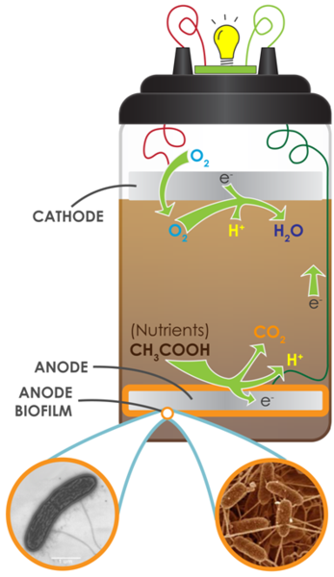
A soil-based MFC

